Slide 1



WELCOME TO
CAREER
CONNECT
A Laravel Web Application to connect your career on a click.

Slide 2


TABLE OF
Contents
01
The Problems We Solve
02
Our Solution
03
User Interface Design
04
Responsive Design
05
Use Case Diagram
06
User authentication
07
Data Validation and Sanitation

Slide 3


THE PROBLMES WE SOLVE
High competition in the job market
Lack of a centralized platform for matching jobs and skills
Difficulty in connecting with employers
Inefficient hiring processes for companies
Solving Problems

Slide 4

OUR
CareerConnect offers to both job seekers and employers
Solution
USER-FRIENDLY JOB PLATFORM
A streamlined interface for both job seekers and employers.
COMPREHENSIVE JOB LISTINGS
Diverse categories and job types for better job matches.
EMPLOYER TOOLS
Features for job posting, applicant management, and communication.
Our Solution
Page 04 of 07

Slide 5



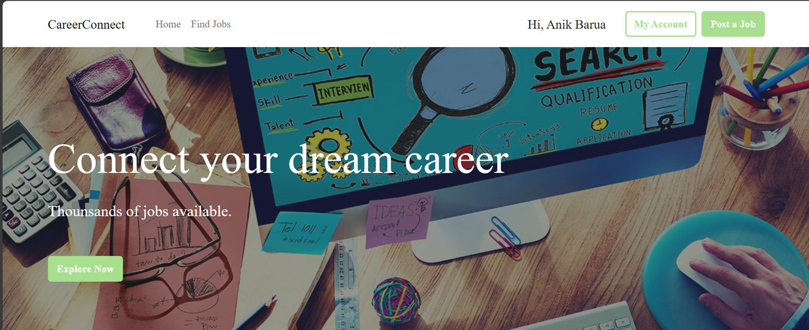
USER INTERFACE DESIGN
Color Theme :
Interface Design
Page 05 of 07

Slide 6

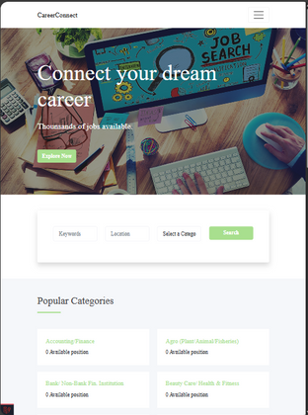
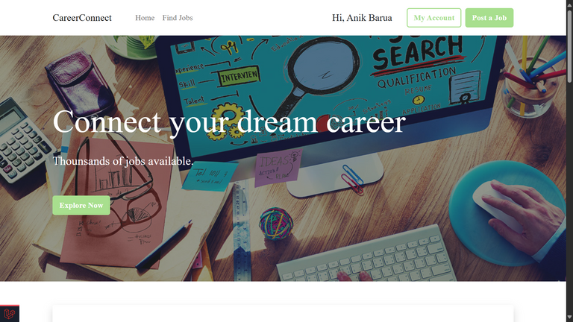
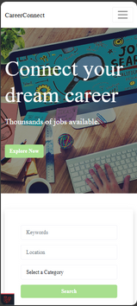

RESPONSIVE
Design
Job Search Strategy
Page 03 of 07

Slide 7
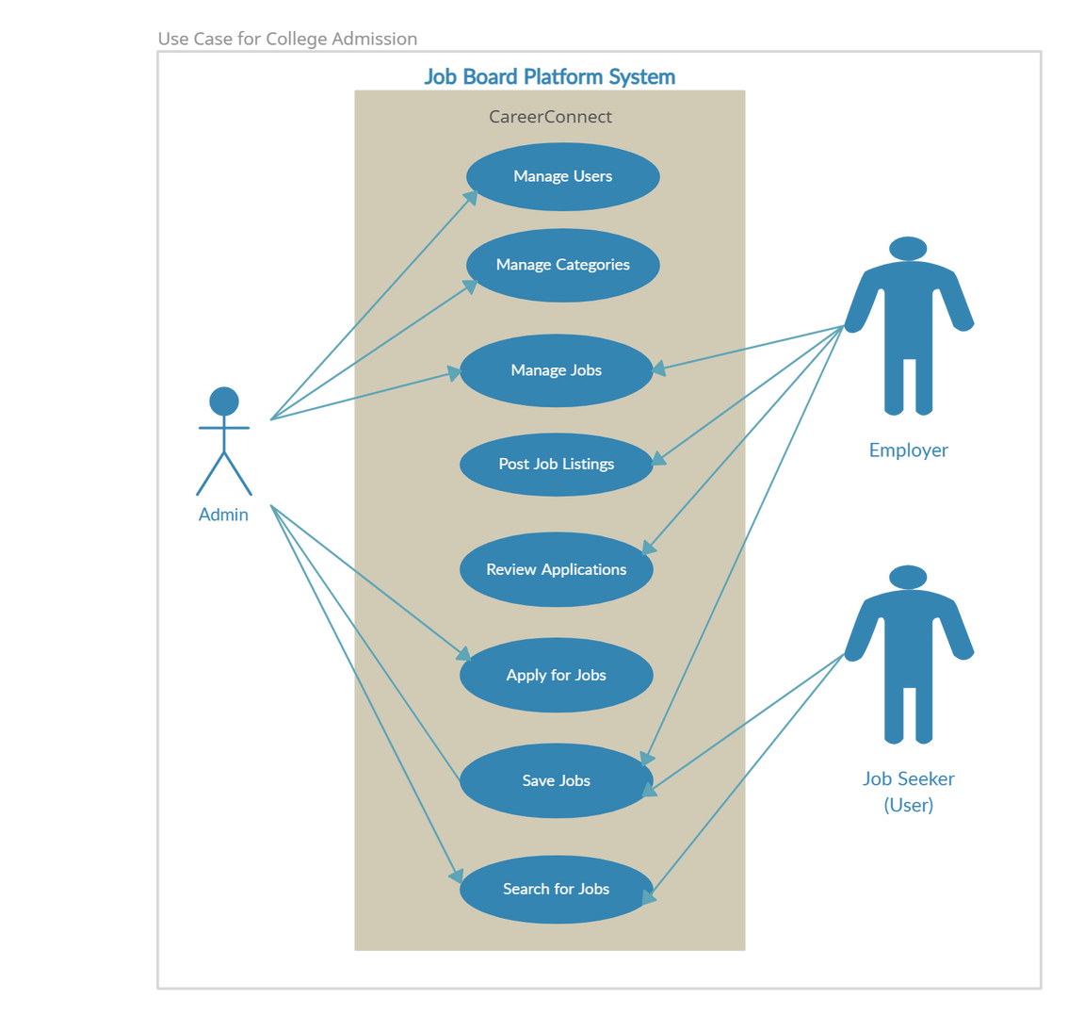
USE
CASE
DIAGRAM
Job Search Strategy
Page 07 of 07

Slide 8

USER AUTHENTICATION AND AUTHORIZATION
Registration: Users can register on the platform. Passwords are hashed using Bcrypt for enhanced security.
Login Process: Password hashing and session management is applied for better experienne online.
Roles and Permissions: Different user roles (admin, user) are handled. Specific access for each role can be changed by admin.
Job Search Strategy
Page 04 of 07

Slide 9

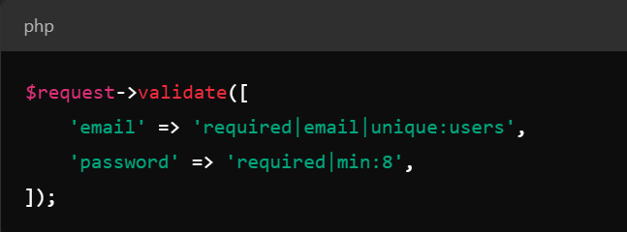
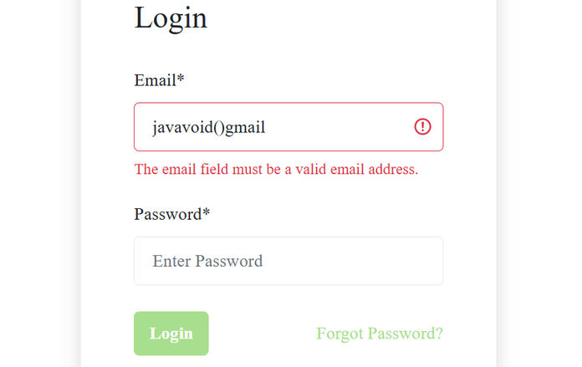
DATA VALIDATION AND SANITATION
All user inputs are validated before processing to prevent SQL injection and XSS attacks.
Utilized Laravel’s built-in validation features to ensure data integrity
Solving Problems
Page 03 of 07

Slide 10
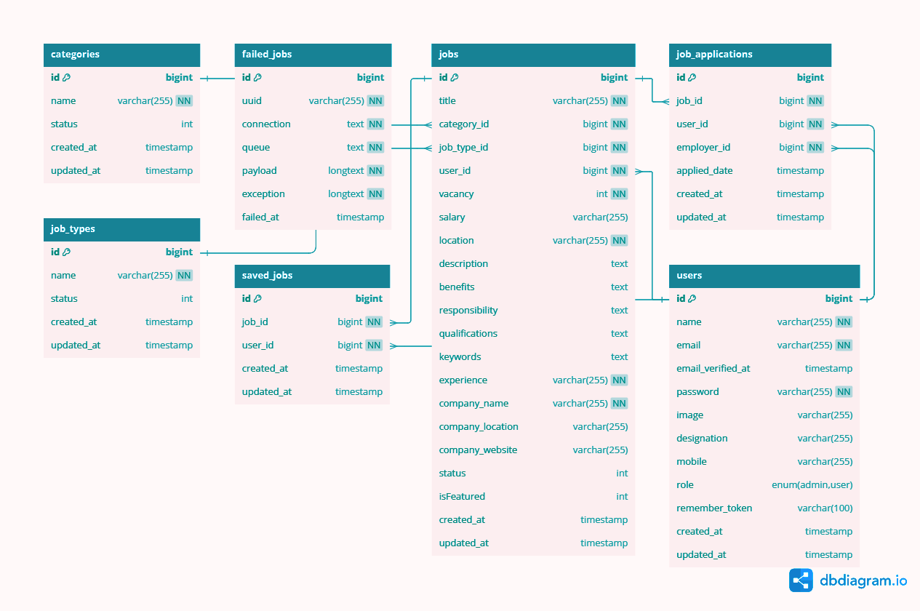

DATABASE DESIGN
Job Search Strategy
Page 05 of 07

Slide 11

DATA MANAGEMENT AND OPTIMIZATION
Data Integrity
Implemented foreign key constraints to maintain data consistency.
Ensured that deleted jobs also remove related applications through cascading deletes.
Added indexes on frequently queried columns like job_id in job applications and email in users for faster lookups.
Indexing Strategies
Utilized Laravel migrations for version control of the database schema.
Database Migrations
Job Search Strategy
Page 07 of 07

Slide 12

TESTING STRATEGIES FOR CAREERCONNECT
Developed unit tests for critical functionalities, including user registration and job posting.
Used PHPUnit to run tests and validate expected outcomes.
Tested the integration between frontend and backend using Laravel Dusk for automated browser testing.
Unit Testing
Integration Testing
Interface Design
Page 05 of 07

Slide 13

RESULTS AND FEEDBACK
Testing Outcomes:
Conducted over 50 unit tests with an 85% pass rate, ensuring critical functionalities are robust.
Identified and resolved 10 bugs during testing, enhancing overall app stability.
User Feedback:
Early user testers praised the intuitive UI and smooth job application process.
Suggested improvements included adding job filters and better search functionality.
Future Testing Plans:
Ongoing testing with real users to gather insights on performance and usability.
Plans for regular updates and enhancements based on user feedback.
Interface Design
Page 05 of 07

Slide 14





THANK
You
123-456-7890
@CareerConnect
www.careerconnect.com
support@careerconnect.co

